Slide 1
Разработка для обучения по английскому языку 5-8 классах
«Проведение досуга»
Автор разработки:
Агарагимова Зарипат Гаджимурадовна

Slide 2
What’s the date today?
What’s the weather like today?
Did you travel a lot?
Where were you?
What did you see?

Slide 4
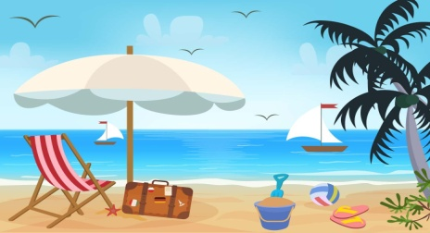
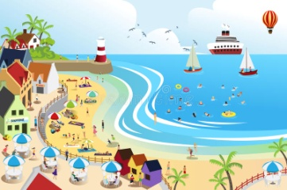
Back
Beach
Diary
During
Find
Resort
Sand
Sandy
Terrible
Go boating
Go fishing
Make sandcastles

Slide 6
Hometask
At home write a letter to your friend and tell him about your summer holidays. стр.56, упр.9.

